Slide 1

The PIV T() TSQL Operators

Slide 2
The PIV T() TSQL Operators
Jeff Foushee
Principal {Various}
Humana, Inc.

Slide 3

SQL Server “MAZSQLWPS001”
Primary Contact: Jeff
Secondary Contact: Ann
ServerName | PropertyName | PropertyValue
MAZSQLWPS001 | Primary Contact | Jeff
MAZSQLWPS001 | Secondary Contact | Ann
ServerName | Primary Contact | Secondary Contact
MAZSQLWPS01 | Jeff | Ann
One piece of truth per line
Horizontal data: New contacts added as rows
Better-suited for data storage
One piece of truth per x/y position
Vertical data: New contacts added as columns
Better-suited for reporting
Notes:
I am part-owner of a server named MAZSQLWPS001, and this needs to be documented as data inside some database.

Slide 4
ServerName | PropertyName | PropertyValue
MAZSQLWPS001 | Primary Contact | Jeff
MAZSQLWPS001 | Secondary Contact | Ann
ServerName | Primary Contact | Secondary Contact
MAZSQLWPS01 | Jeff | Ann
There will be times where your data must be converted:
A feed you import does not fit into your model
Data you export does not fit into the target model
Data summarization, reporting
Notes:
The real world does not conform to the same standards on storing data.
Data may need to be transformed to meet disparate business requirements, or to summarize

Slide 5




Jeff Foushee
SQL Server Database Admin
Programmer
SQL Saturday speaker
Blackjack dealer
https://www.linkedin.com/in/jeff-foushee/
https://github.com/jbfoushee/MyPresentations/

Slide 8


Get your SQL Questions answered here by our SQL Experts
(Across from Registration)

Slide 9


501 Legion Charitable Donation & LEGO Drive
Thank the 501 Legion for Supporting Our Event!
JSSUG Will Match Donations up to $1000
Donation Bucket on Registration Table
LEGO donation on V for Victory Table

Slide 10
Session Evaluations
Your feedback is important to us!
Please fill out and hand to speaker after the session!

Slide 11
Event Evaluation
Fill out event evaluation card in your bag and visit all sponsors to be entered to win an Xbox Series X – (Must be present to win)

Slide 12
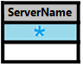
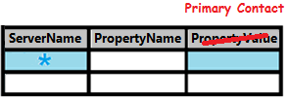
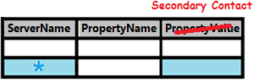
Converting Vertical Data to Horizontal
ServerName | PropertyName | PropertyValue
MAZSQLWPS001 | Primary Contact | Jeff
MAZSQLWPS001 | Secondary Contact | Ann
ServerName | Primary Contact | Secondary Contact
MAZSQLWPS001 | Jeff | Ann
SELECT base.ServerName AS ServerName
, pri.PropertyValue AS [Primary Contact]
, sec.PropertyValue AS [Secondary Contact]
FROM
( SELECT DISTINCT ServerName
FROM [Table1]
) base
FULL OUTER JOIN
( SELECT ServerName, PropertyValue
FROM [Table1]
WHERE PropertyName = 'Primary Contact'
) pri
ON base.ServerName = pri.ServerName
FULL OUTER JOIN
( SELECT ServerName, PropertyValue
FROM [Table1]
WHERE PropertyName = 'Secondary Contact'
) sec
ON base.ServerName = sec.ServerName
Notes:
Let’s take a look at taking vertical data and turn it horizontal.
This could be accomplished using FULL OUTER JOINs
For each unique value in the PropertyName column, a new FULL OUTER JOIN is required
This is fine for a small number of columns…

Slide 13
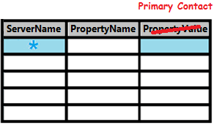
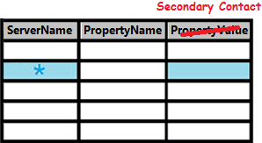
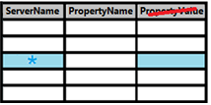
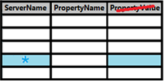

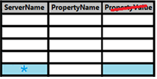
Converting Vertical Data to Horizontal
ServerName | PropertyName | PropertyValue
MAZSQLWPS001 | Primary Contact | Jeff
MAZSQLWPS001 | Secondary Contact | Ann
MAZSQLWPS001 | Tertiary Contact | Chris
MAZSQLWPS001 | Access Approver | Dan
MAZSQLWPS001 | Patching Approver | Joanne
ServerName | Primary… | Secondary… | Tertiary… | Access… | Patching…
MAZSQLWPS001 | Jeff | Ann | Chris | Dan | Joanne
SELECT base.ServerName AS ServerName
, pri.PropertyValue AS [Primary Contact]
, sec.PropertyValue AS [Secondary Contact]
, tri.PropertyValue AS [Tertiary Contact]
, access.PropertyValue AS [Access Approver]
, patch.PropertyValue AS [Patching Approver]
FROM
( SELECT DISTINCT ServerName FROM [Table1]) base
FULL OUTER JOIN
( SELECT ServerName, PropertyValue FROM [Table1] WHERE PropertyName = 'Primary Contact') pri
ON base.ServerName = pri.ServerName
FULL OUTER JOIN
( SELECT ServerName, PropertyValue FROM [Table1] WHERE PropertyName = 'Secondary Contact') sec
ON base.ServerName = sec.ServerName
FULL OUTER JOIN
( SELECT ServerName, PropertyValue FROM [Table1] WHERE PropertyName = Tertiary Contact') tri
ON base.ServerName = tri.ServerName
FULL OUTER JOIN
( SELECT ServerName, PropertyValue FROM [Table1] WHERE PropertyName = Access Approver') access
ON base.ServerName = access.ServerName
FULL OUTER JOIN
( SELECT ServerName, PropertyValue FROM [Table1] WHERE PropertyName = Patching Approver') patch
ON base.ServerName = patch.ServerName
Notes:
But what about when new requirements are added?
The code gets pretty unreadable.
There must be an easier way!

Slide 14

Notes:
What if I told you that Microsoft has already provided a way to make this easier?
And thankfully, there is no additional product you have to buy.

Slide 15


What is a pivot?
A pivot is a point or set of points, on the end of which
something rests and turns
something rotates or oscillates.
http://dictionary.reference.com/browse/pivoted?s=t
Notes:
A pivot is a theoretical point or set of points that stay stationary while something rotates or spins about it.
Some example motions are a see-saw, a door hinge,

Slide 16

Torque / Force
Pivot
Notes:
The example of the wrench turning a bolt will be used for demonstrative purposes against data.

Slide 17



“Imagine” how this would apply to data
Less rows, more columns
Vertical data
Horizontal data
Notes:
In this oversimplified demonstration, what if I could take a wrench and rotate that data?
Look how we get more columns, and fewer rows.
This is not quite the result, but the rotation will be helpful to explain later.

Slide 18
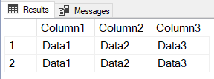
The PIVOT operator promotes data to column headers
Notes:
We’ll depict the PIVOT as a clockwise function to further describe this passage.
In every dataset, there is a box that represents neither a row header nor a column header… but it borders both columns and data.
Any data that will become a column header has to pass though the “magic square” to transcend functionality.
Coincidentally, the letter “P” is generally written using a clockwise circle.

Slide 19
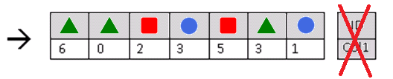
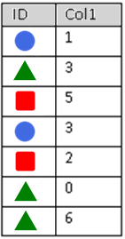
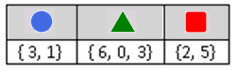
How a PIVOT works on data
But what is ultimately presented back to the client?
Notes:
Let’s look at some basic arbitrary data.
The PIVOT operator takes the data and turns it clockwise, causing data to promote to the column headers. The original column headers are removed.
However, the rotated dataset is invalid because it uses repeating column headers.
To solve this, the data is temporarily condensed into “holding tanks” by column.
But what is ultimately presented back to the client?

Slide 20
An aggregates refresher
An aggregate value is a solitary value that summarizes a list of values, even a list of one
Aggregate | Alphanumerics | Dates | Numerics | Datarows with NULLs | NULL-only records, or record-less
COUNT() | þ | þ | þ | Not counted towards final result | 0
COUNT_BIG() | þ | þ | þ | Not counted towards final result | 0
MIN() | þ | þ | þ | Not counted towards final result | NULL
MAX() | þ | þ | þ | Not counted towards final result | NULL
SUM() |  |  | þ | Not counted towards final result | NULL
AVG() |  |  | þ | Not counted towards final result | NULL
See Books Online for additional aggregates, as well as any aggregate-to-datatype limitations.
Notes:
You must use an aggregate function, even if you have one value to aggregate.
Make sure your alphanumeric data is scrubbed before applying aggregates upon it.
Min/Max are usually not adequate aggregates for alphanumerics, e.g. a list of names, so make ensure you don’t have multiple values.

Slide 21
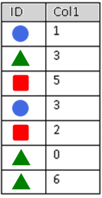

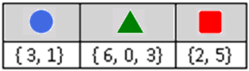
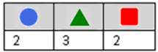
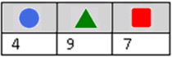
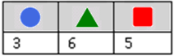
PIVOT
<AGG>([Col1])
FOR [ID] IN ( , , )
PIVOT
COUNT([Col1])
FOR [ID] IN ( , , )
PIVOT
SUM([Col1])
FOR [ID] IN ( , , )
PIVOT
MAX([Col1])
FOR [ID] IN ( , , )
Notes:
This syntax is the main part of understanding the PIVOT statement.
Cannot stress this enough: Because values are aggregated, you get one and only one resulting value.
You cannot result with the raw array or list.

Slide 22



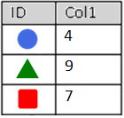
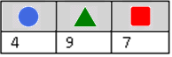
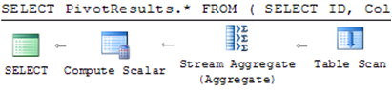
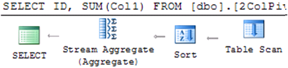
PIVOT() LIKE/!= GROUP BY
PIVOT
GROUP BY
SELECT PivotResults.*
FROM (
SELECT ID, Col1
FROM dbo.Table_1
) AS RawData
PIVOT (
SUM(Col1)
FOR [ID]
IN ([ ],[ ],[ ])
) AS PivotResults
SELECT ID
, SUM(Col1) AS Col1
FROM dbo.Table_1
GROUP BY ID
Notes:
While both the PIVOT and GROUP BY clauses aggregate results, they do not share the same output structure, nor the same execution plan.

Slide 23

Breakdown of PIVOT statement (1/4)
Exactly one aggregate can be applied
Exactly one column can be aggregated
PIVOT (
SUM(Col1)
FOR [ID]
IN ([Circle], [Triangle], [Square])
)
Exactly one column’s values can be
promoted into the column header
Table_1
PivotResults
Each “value-turned-column” (VTC)
Must be explicitly requested at compile-time:
Once. Repeated times will result in a parse error
Sub-queries and variables are not allowed here
“But what if I don’t know them at compile-time?” Stay tuned
Strong recommendation to enclose in braces
Notes:
These rules apply to each PIVOT clause. You can re-PIVOT a PIVOTed statement, though I personally have yet to find a valid case study for this.
Microsoft calls them “pivoted columns,” but I will use “Values-Turned-Columns”
The glossary term “VTC” will be used elsewhere.

Slide 24
Breakdown of PIVOT statement (2/4)
SELECT
FROM (
SELECT ID, Col1 FROM dbo.Table_1
)
PIVOT (
SUM(Col1)
FOR [ID]
IN ([Circle], [Triangle], [Square])
)
Original dataset
Table_1
PivotResults
Notes:
The original dataset is the one you want to index for

Slide 25
Breakdown of PIVOT statement (3/4)
SELECT
FROM (
SELECT ID, Col1 FROM dbo.Table_1
) AS RawData
PIVOT (
SUM(Col1)
FOR [ID]
IN ([Circle], [Triangle], [Square])
) AS PivotResults
Table_1
Both predicates must be named
PivotResults
Notes:
I use “RawData” and “PivotResults” to identify my predicates easily, but you can use any name.

Slide 26
Breakdown of PIVOT statement (4/4)
SELECT PivotResults.*
FROM (
SELECT ID, Col1 FROM dbo.Table_1
) AS RawData
PIVOT (
SUM(Col1)
FOR [ID]
IN ([Circle], [Triangle], [Square])
) AS PivotResults
Table_1
And then select the correct predicate
PivotResults
You cannot directly select values from this predicate
Notes:
And select the correct predicate.
Congrats, you have transformed the dataset provided by “RawData” into a new dataset named “PivotResults.”
You cannot explicitly request any columns from RawData into the SELECT predicate.
You don’t have to qualify the * with “PivotResults”

Slide 27
Demo of a 2-column PIVOT
See Github for source code

Slide 28
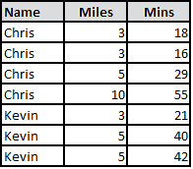
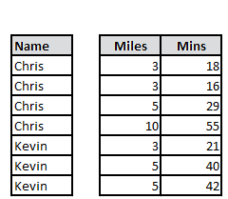
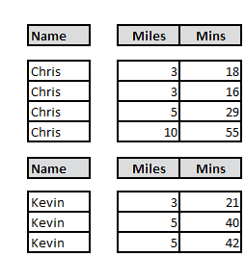
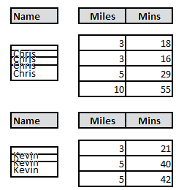
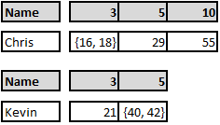
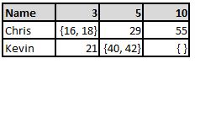
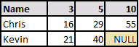
How a 3-column PIVOT works…
SELECT PivotResults.*
FROM (
SELECT [Name], Miles, Mins FROM ...
) AS RawData
PIVOT (
MIN(Mins)
FOR [Miles]
IN ([3], [5], [10])
) AS PivotResults

Slide 29
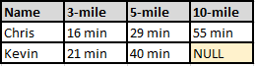
SELECT PivotResults.*
FROM (
SELECT [Name], Miles, Mins
FROM ...
) AS RawData
PIVOT (
MIN(Mins)
FOR [Miles]
IN ([3], [5], [10])
) AS PivotResults
SELECT PivotResults.[Name]
, PivotResults.[3]
, PivotResults.[5]
, PivotResults.[10]
SELECT PivotResults.[Name]
, CONVERT(varchar, PivotResults.[3]) + ' min' AS [3-mile]
, CONVERT(varchar, PivotResults.[5]) + ' min' AS [5-mile]
, CONVERT(varchar, PivotResults.[10])+ ' min' AS [10-mile]

Slide 30
StoreID | [Quarter] | [Year] | Sales |  | DataEnteredBy
1 | 1 | 20XX | 10000 |  | Mary
1 | 2 | 20XX | 15000 |  | Chris
1 | 3 | 20XX | 17500 |  | Mary
1 | 4 | 20XX | 18000 |  | Mary
1 | 1 | 20XY | 22000 |  | Chris
1 | 2 | 20XY | 35000 |  | Bob
1 | 3 | 20XY | 40000 |  | Chris
1 | 4 | 20XY | 60000 |  | Mary
1 | 1 | 20XZ | 38000 |  | Mary
1 | 2 | 20XZ | 32000 |  | Chris
1 | 3 | 20XZ | 45000 |  | Bob
1 | 4 | 20XZ | 50000 |  | Chris
2 | 1 | 20XY | 20000 |  | Kim
2 | 2 | 20XY | 15000 |  | Kim
2 | 3 | 20XY | 30000 |  | Kim
2 | 4 | 20XY | 8000 |  | Lee
2 | 1 | 20XZ | -3000
3 | 2 | 20XZ | 50000 |  | Jerry
3 | 3 | 20XZ | 30000 |  | Jerry
3 | 4 | 20XZ | 50000 |  | Bill

Slide 31
Demo of a 3-column PIVOT
See Github for source code

Slide 32
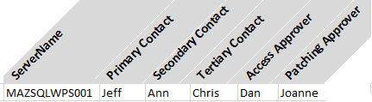


ServerName | PropertyName | PropertyValue
MAZSQLWPS001 | Primary Contact | Jeff
MAZSQLWPS001 | Secondary Contact | Ann
MAZSQLWPS001 | Tertiary Contact | Chris
MAZSQLWPS001 | Access Approver | Dan
MAZSQLWPS001 | Patching Approver | Joanne
The FULL OUTER JOIN method…
The PIVOT method…
SELECT base.ServerName AS ServerName
, pri.PropertyValue AS [Primary Contact]
, sec.PropertyValue AS [Secondary Contact]
, tri.PropertyValue AS [Tertiary Contact]
, access.PropertyValue AS [Access Approver]
, patch.PropertyValue AS [Patching Approver]
FROM
( SELECT DISTINCT ServerName FROM [Table1]
) base
FULL OUTER JOIN
( SELECT ServerName, PropertyValue FROM [Table1] WHERE PropertyName = 'Primary Contact'
) pri
ON base.ServerName = pri.ServerName
FULL OUTER JOIN
( SELECT ServerName, PropertyValue FROM [Table1] WHERE PropertyName = 'Secondary Contact'
) sec
ON base.ServerName = sec.ServerName
FULL OUTER JOIN
( SELECT ServerName, PropertyValue FROM [Table1] WHERE PropertyName = Tertiary Contact'
) tri
ON base.ServerName = tri.ServerName
FULL OUTER JOIN
( SELECT ServerName, PropertyValue FROM [Table1] WHERE PropertyName = Access Approver'
) access
ON base.ServerName = access.ServerName
FULL OUTER JOIN
( SELECT ServerName, PropertyValue FROM [Table1] WHERE PropertyName = Patching Approver'
) patch
ON base.ServerName = patch.ServerName
SELECT PivotResults.*
FROM (
SELECT ServerName
, PropertyName
, PropertyValue
FROM [Table1]
) AS RawData
PIVOT (
MAX(PropertyValue)
FOR [PropertyName]
IN ([Primary Contact]
, [Secondary Contact]
, [Tertiary Contact]
, [Access Approver]
, [Patching Approver])
) AS PivotResults
Notes:
So back to our original example, which is a 3-column PIVOT
As long as I’m guaranteed one value per contact type

Slide 33
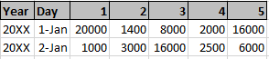
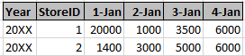
How do I manage my VTCs? (1/4)
Option 1: Don’t. Pivot for items that grow slowly over time.
PIVOT (
SUM(Sales)
FOR [StoreID]
IN ([1], [2], [3],
[4], [5])
)
This:
Not This:
PIVOT (
SUM(Sales)
FOR [Day]
IN ([1-Jan], [2-Jan],
[3-Jan], [4-Jan],
[5-Jan] , ...)
)
…
…
…
Supported by ad-hoc queries
Supported by stored procedures
Supported by views

Slide 34
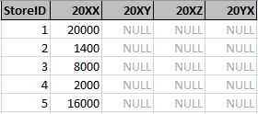
How do I manage my VTCs? (2/4)
Option 2: Explicitly request the ones of interest; Provision for future extras
PIVOT (
SUM(Sales)
FOR [Year]
IN ([20XX],
[20XY],
[20XZ],
[20YX]
)
Supported by ad-hoc queries
Supported by stored procedures
Supported by views

Slide 35
How do I manage my VTCs? (3/4)
Option 3: Use dynamic SQL
DECLARE @_VTCNames varchar(MAX); SET @_VTCNames = ''
Option 3a: Cursor-based
Option 3b: XML-based
DECLARE Cursor_VTCNames CURSOR LOCAL FAST_FORWARD FOR
SELECT DISTINCT [Year] FROM ... ORDER BY [Year]
DECLARE @_$variable varchar(50)
DECLARE @_rowcount integer; SET @_rowcount = 0
OPEN Cursor_VTCNames
FETCH NEXT FROM Cursor_VTCNames INTO @_$variable
WHILE @@FETCH_STATUS = 0
BEGIN
SET @_rowcount += 1
IF @_rowcount > 1 SET @_VTCNames = @_VTCNames + ','
SET @_VTCNames = @_VTCNames + '[' + @_$variable + ']'
FETCH NEXT FROM Cursor_VTCNames INTO @_$variable
END
CLOSE Cursor_VTCNames; DEALLOCATE Cursor_VTCNames
SET @_VTCNames = STUFF(
(
SELECT ', [' + [Year] + ']'
FROM ( SELECT DISTINCT [Year] FROM ... ) AS T
ORDER BY [Year]
FOR XML PATH(''), TYPE
).value('(./text())[1]','varchar(MAX)'),1,2,'');
Option 3c: STRING_AGG function (SQL 2017+)
SELECT @_VTCNames =
CONCAT('[', STRING_AGG([Year], '],['), ']')
FROM
(SELECT DISTINCT [Year] FROM ...
ORDER BY [Year]
) a
Notes:
Essentially, you’ll be constructing the PIVOT’s IN-clause.
You want to order the columns into a logical order, and only look for unique data
Many thanks to MSDN forums for the XML conversion technique:
http://social.msdn.microsoft.com/Forums/sqlserver/en-US/2ab88114-be39-40f7-bed0-99d30b6fbc43/set-variable-to-distinct-array-returned-by-for-xml?forum=transactsql

Slide 36
How do I manage my VTCs? (4/4)
Option 3 (cont.): Use dynamic SQL
DECLARE @_VTCNames varchar(MAX); SET @_VTCNames = ''
-- Load your @_VTCNames variable using an option from previous slide
DECLARE @_SQLStmt varchar(MAX); SET @_SQLStmt = ''
SET @_SQLStmt = @_SQLStmt + ' SELECT PivotResults.* '
SET @_SQLStmt = @_SQLStmt + ' FROM ( ... ) AS RawData '
SET @_SQLStmt = @_SQLStmt + ' PIVOT ( '
SET @_SQLStmt = @_SQLStmt + ' SUM(Sales) '
SET @_SQLStmt = @_SQLStmt + ' FOR [Year] '
SET @_SQLStmt = @_SQLStmt + ' IN (' + @_VTCNames + ')'
SET @_SQLStmt = @_SQLStmt + ' ) AS PivotResults'
SET @_SQLStmt = @_SQLStmt + ' ORDER BY 1 ASC; '
EXEC(@_SQLStmt)
Ensures the first column is sorted, regardless of datatype
Supported by ad-hoc queries
Supported by stored procedures
Not supported by views
Notes:
Essentially, you’ll be constructing the PIVOT’s IN-clause.
You want to order the columns into a logical order, and only look for unique data

Slide 37
Demo of a dynamic PIVOT
See Github for source code

Slide 38
The n-column PIVOT

Slide 39
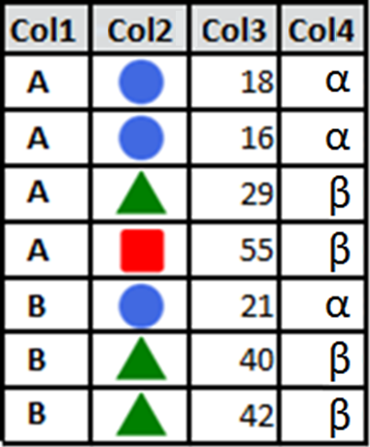
How a n-column PIVOT works…
SELECT PivotResults.*
FROM (
SELECT Col1, Col2, Col3, Col4
FROM ...
) AS RawData
PIVOT (
SUM(Col3)
FOR [Col2]
IN ( , , )
) AS PivotResults
Notes:
Advanced explanation of the PIVOT
RawData should hold data related to the outcome of the input. For our marathon demo: name, maybe weather, what they ate…
Not who entered the data

Slide 40
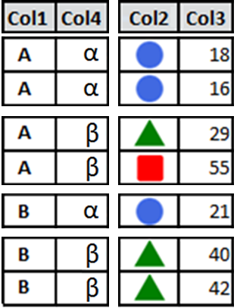
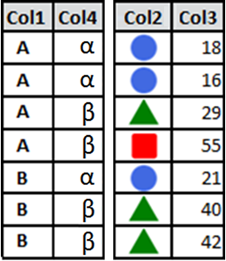
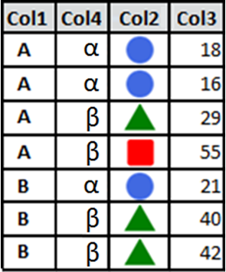

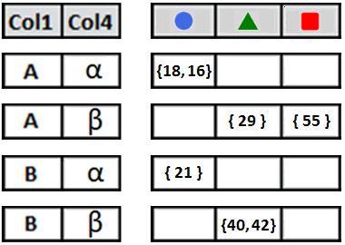
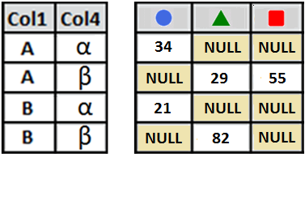
How a n-column PIVOT works…
Non-pivots ← → Pivoted columns
SELECT PivotResults.*
FROM (
SELECT Col1, Col2, Col3, Col4
FROM ...
) AS RawData
PIVOT (
SUM(Col3)
FOR [Col2]
IN ( , , )
) AS PivotResults
Horizontal separation of “DISTINCT” combos
Notes:
Advanced explanation of the PIVOT
RawData should hold data related to the outcome of the input. For our marathon demo: name, maybe weather, what they ate…
Not who entered the data

Slide 41
Random extra PIVOT trivia…

Slide 42

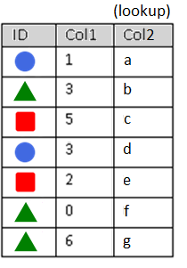
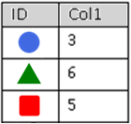
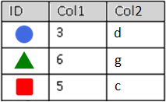
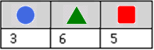
The “ugly” of PIVOT… lookups
PIVOT
GROUP BY
SELECT PivotResults.*
FROM (
SELECT ID, Col1
FROM dbo.Table_1
) AS RawData
PIVOT (
MAX(Col1)
FOR [ID]
IN ([ ],[ ],[ ])
) AS PivotResults
SELECT ID
, MAX(Col1) AS Col1
FROM dbo.Table_1
GROUP BY ID
Notes:
I want you to be informed, so I need to show you the ugly side of the PIVOT statement.
I will use the GROUP BY slide from earlier, but the scenario is as follows:
I want the MAX of Col1, grouped by ID, but the associated Col2 value with it

Slide 43

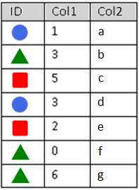
The “ugly” of PIVOT… lookups
PIVOT
GROUP BY
SELECT PivotResults.*
FROM (
SELECT ID, Col1
FROM dbo.Table_1
) AS RawData
PIVOT (
MAX(Col1)
FOR [ID]
IN ([ ],[ ],[ ])
) AS PivotResults
SELECT orig.ID
, orig.Col1
, orig.Col2
FROM dbo.Table_1 orig
INNER JOIN
( SELECT ID
, MAX(Col1) AS Col1
FROM dbo.Table_1
GROUP BY ID
) maxes
ON orig.ID = maxes.ID
AND orig.Col1 = maxes.Col1
INNER JOIN dbo.Table_1
ON ?????
Notes:
I can do this fairly easily with the GROUP BY statement, but how to do this with the PIVOT?
It’s not like I can join the PivotResults back to Table_1; the columns don’t even match.

Slide 44

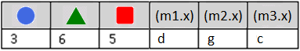
The “ugly” of PIVOT… lookups
PIVOT
GROUP BY
SELECT PivotResults.*
, m1.x, m2.x, m3.x
FROM (
SELECT ID, Col1
FROM dbo.Table_1
) AS RawData
PIVOT (
MAX(Col1)
FOR [ID]
IN ([ ],[ ],[ ])
) AS PivotResults
CROSS JOIN
( SELECT MAX(Col1) AS x
FROM dbo.Table_1 WHERE ID = ) m1
CROSS JOIN
( SELECT MAX(Col1) AS x
FROM dbo.Table_1 WHERE ID = ) m2
CROSS JOIN
( SELECT MAX(Col1) AS x
FROM dbo.Table_1 WHERE ID = ) m3
SELECT orig.ID
, orig.Col1
, orig.Col2
FROM dbo.Table_1 orig
INNER JOIN
( SELECT ID
, MAX(Col1) AS Col1
FROM dbo.Table_1
GROUP BY ID
) maxes
ON orig.ID = maxes.ID
AND orig.Col1 = maxes.Col1
Notes:
I can do a CROSS JOIN against the original table, but I have to do one for each distinct VTC. And then circularly, how many VTCs are there?

Slide 45

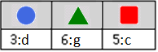
The “ugly” of PIVOT… lookups
PIVOT
GROUP BY
SELECT PivotResults.*
FROM (
SELECT orig.ID
, CONCAT(orig.Col1, ':', orig.Col2)
AS Caption
FROM dbo.Table_1 orig
INNER JOIN
( SELECT ID, MAX(Col1) AS Col1
FROM dbo.Table_1
GROUP BY ID
) maxes
ON orig.ID = maxes.ID
AND orig.Col1 = maxes.Col1
) AS RawData
PIVOT (
MAX(Caption)
FOR [ID]
IN ([ ],[ ],[ ])
) AS PivotResults
SELECT orig.ID
, orig.Col1
, orig.Col2
FROM dbo.Table_1 orig
INNER JOIN
( SELECT ID
, MAX(Col1) AS Col1
FROM dbo.Table_1
GROUP BY ID
) maxes
ON orig.ID = maxes.ID
AND orig.Col1 = maxes.Col1
Notes:
In this example, I take the entire query of the GROUP BY as the query of the RawContents.
I merge Col1 and Col2 into a character-separated Caption, and then PIVOT the caption.
On the outer SELECT, I can parse the caption with CHARINDEX functions.

Slide 46
Demo of PIVOT lookups
On your own time
See Github for source code

Slide 47
One more limitation of the PIVOT
PIVOT (
SUM(Col1)
FOR [ID]
IN ([Circle], [Triangle], [Square])
)
ü
û
û
û
û
SUM(Col1)
SUM(Col1 * 10)
SUM(Col1) * 10
SUM(IsNull(Col1, 12))
SUM(CASE WHEN Col1 > 1000 THEN Col1 ELSE 0 END)
Notes:
Aggregate, Column, full-stop.
No calculations, no functions, no logic.
I left this at the end because this should be the least of your worries at this point.
All of these can be satisfied by SELECT/WHERE conditions in RawData. In some cases, the outer SELECT clause as well.

Slide 48

Questions about the PIVOT operator?
Coming up next → The UNPIV T operator…

Slide 49
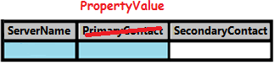
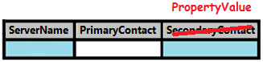
Converting Horizontal Data to Vertical
ServerName | Primary Contact | Secondary Contact
MAZSQLWPS01 | Jeff | Ann
ServerName | PropertyName | PropertyValue
MAZSQLWPS001 | Primary Contact | Jeff
MAZSQLWPS001 | Secondary Contact | Ann
SELECT ServerName
, 'Primary Contact' AS PropertyName
, [Primary Contact] AS PropertyValue
FROM [Table2]
UNION ALL
SELECT ServerName
, 'Secondary Contact' AS PropertyName
, [Secondary Contact] AS PropertyValue
FROM [Table2]
+
UNION ALL...
UNION ALL...
Notes:
How could I take horizontal data and change it to vertical data?
Note that the data is going in the reverse direction.
One idea would be the UNION ALL statement.
Notice for each column on the right-hand dataset, I need another UNION ALL statement.

Slide 50
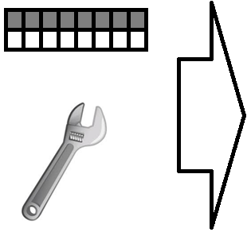

“Imagine” how this would apply to data
More rows, less columns
Horizontal data
Vertical data
Notes:
In this oversimplified demonstration, what if I could take a wrench and rotate that data?
Look how we get less columns, and more rows.
This is not quite the result, but the rotation will be helpful to explain later.

Slide 51
An UNPIVOT demotes column headers into data
Notes:
For column headers to transcend to data elements, they need to move counter-clockwise though the magic square.
The curve of the letter “U” is written counter-clockwise as well (reminds you which operation to use based on rotation).

Slide 52
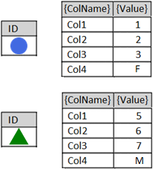





How an UNPIVOT works
…
Datatype?
Notes:
Let’s say Col1, Col2, and Col3 are tinyints, and Col4 is a one-character string.
After the animation, what datatype would satisfy the merged values?

Slide 53
The Lowest Common Denominator
All run-time values merged by UNPIVOT must be able to fit in one common datatype without overflow (range of values), truncation (length of values), or collation (unicode / case-sensitivity) issues.
Col1 = int
Col2 = bigint
Resulting {Value} column may need to be defined as bigint
Col1 = int
Col2 = bigint
Col3 = varchar(10)
Resulting {Value} column may need to be varchar(20)
Col1 = int
Col2 = bigint
Col3 = varchar(50)
Col4 = nchar(2000)
or smaller…
Resulting {Value} column may need to be
nvarchar(2000)
Notes:
Balance your current/future needs such that your common datatype continues to work, yet doesn’t bloat tempdb with unnecessary sizes.
Consider the theoretical minimums/maximums of the combined datatypes.
(A bigint could have a value of 9 quintillion which is 19 characters long when typed out. Add one more character for the negative sign.)
But if you’re not using extremes in your data (datatype maximums/minimums/lengths), could you go even smaller?

Slide 54

Breakdown of UNPIVOT statement (1/5)
Table_1
UNPIVOT (
PropertyValue
FOR PropertyName
IN ([Col1], [Col2], [Col3], [Col4])
)
Brackets required only when column name contains spaces
UnpivotResults
Decide on new column names
These represent the key/value pairs to be returned
Notes:
Your new {ColName} and {Value} columns could be as simple as ‘PropertyName’ and ‘PropertyValue’

Slide 55
Breakdown of UNPIVOT statement (2/5)
Table_1
SELECT
FROM (
SELECT ID
, Col1
, Col2
, Col3
, Col4
FROM dbo.Table_1
)
UNPIVOT (
PropertyValue
FOR PropertyName
IN ([Col1], [Col2], [Col3], [Col4])
)
Original dataset
tinyint
UnpivotResults
char(1)
Notes:
Add my original dataset… oh yeah, but these datatypes clash.
What datatype do I need such that the data gets along?
Have I reviewed past, present and future values?
Am I storing this for personal use, or am I going to redirect programs to come get their data here?

Slide 56
Breakdown of UNPIVOT statement (3/5)
Table_1
SELECT
FROM (
SELECT ID
, Convert(char(3),Col1)
, Convert(char(3),Col2)
, Convert(char(3),Col3)
, Convert(char(3),Col4)
FROM dbo.Table_1
)
UNPIVOT (
PropertyValue
FOR PropertyName
IN ([Col1], [Col2], [Col3], [Col4])
)
Convert to common
datatypes as necessary
AS Col1
AS Col2
AS Col3
AS Col4
UnpivotResults
Re-alias column name to itself,
for the UNPIVOT mappings to work
Notes:
I have decided that I want a char(3) conversion.
Once I use a Convert function on a value, the column’s name is lost.
I have to use the AS clause to re-establish the mapping between the original query and UNPIVOT’s IN-clause

Slide 57
Breakdown of UNPIVOT statement (4/5)
Table_1
SELECT
FROM (
SELECT ID
, Convert(char(3),Col1) AS Col1
, Convert(char(3),Col2) AS Col2
, Convert(char(3),Col3) AS Col3
, Convert(char(3),Col4) AS Col4
FROM dbo.Table_1
) AS RawData
UNPIVOT (
PropertyValue
FOR PropertyName
IN ([Col1], [Col2], [Col3], [Col4])
) AS UnpivotResults
UnpivotResults
Both predicates must be named
Notes:
Both predicates must be named with something

Slide 58
Breakdown of UNPIVOT statement (5/5)
Table_1
SELECT UnpivotResults.*
FROM (
SELECT ID
, Convert(char(3),Col1) AS Col1
, Convert(char(3),Col2) AS Col2
, Convert(char(3),Col3) AS Col3
, Convert(char(3),Col4) AS Col4
FROM dbo.Table_1
) AS RawData
UNPIVOT (
PropertyValue
FOR PropertyName
IN ([Col1], [Col2], [Col3], [Col4])
) AS UnpivotResults
UnpivotResults
And select the correct predicate
Notes:
Do I have to preface the star with UnpivotResults? No.

Slide 59


But what if there were NULLs in the data?
Table_1
?
SELECT *
FROM (
SELECT ID
, Convert(char(3),Col1) AS Col1
, Convert(char(3),Col2) AS Col2
, Convert(char(3),Col3) AS Col3
, Convert(char(3),Col4) AS Col4
FROM dbo.Table_1
) AS RawData
UNPIVOT (
PropertyValue
FOR PropertyName
IN ([Col1], [Col2], [Col3], [Col4])
) AS UnpivotResults
UnpivotResults
Notes:
When we look at the demo, we’ll find the “{Circle, Col3, NULL}” and “{Triangle, Col2, NULL}” records do not transfer to the UnpivotResults recordset.
You can force these records into the resultset by using the IsNull function to display some alternate text.
However, your alternate text will also be bound by the lowest common denominator rule from 6 slides ago.

Slide 60
Demo of an UNPIVOT
See Github for source code

Slide 61

The XML-based unpivot
DECLARE @MyString varchar(20) = '1 2 3 4 5'
DECLARE @MyString_XML XML
= CAST(
'<root><item>'
+ Replace(@MyString, ' ', '</item><item>')
+ '</item></root>'
AS XML)
SELECT t.value('.', 'varchar(max)') AS blah
FROM @MyString_XML.nodes('//root/item') AS a(t)

Slide 62

Time for a level-set….
(level set)

Slide 63

CROSS APPLY
Not a JSON function. Acquires a subset of data for each row found by the outer query. Behaves like an INNER JOIN: if no subset if found, the outer row disappears from the result set.
SELECT c.*, o.*
FROM Customers c
INNER JOIN Orders o
ON c.CustomerID = o.CustomerID
INNER JOIN
( SELECT CustomerID
, MAX(OrderDate) AS OrderDate
FROM Orders
GROUP BY CustomerID
) latest1
ON o.CustomerID = latest1.CustomerID
AND o.OrderDate = latest1.OrderDate
SELECT c.*, ca.*
FROM Customers c
CROSS APPLY
( SELECT TOP 1 *
FROM Orders o
WHERE o.CustomerId = c.CustomerId
ORDER BY OrderDate DESC
) ca
SQL Server 2005+
Azure SQL Database
Azure SQL Managed Instance
Azure Synapse Analytics
SQL analytics endpoint in Microsoft Fabric
Warehouse in Microsoft Fabric
Notes:
Also known as a “lateral join”

Slide 64
CROSS APPLY
Acquires a subset of data for each row found by the outer query. Behaves like an INNER JOIN: if no subset if found, the outer row disappears from the result set.
SELECT c.*, o.*
FROM Customers c
INNER JOIN Orders o
ON c.CustomerId = o.CustomerId
INNER JOIN
(
SELECT CustomerId, OrderDate
FROM
(
SELECT ROW_NUMBER()
OVER(PARTITION BY CustomerID
ORDER BY OrderDate DESC)
AS [Rank]
, CustomerId
, OrderDate
FROM Orders
) latest
WHERE [Rank] <= 2
) latest2
ON o.CustomerID = latest2.CustomerId
AND o.OrderDate = latest2.OrderDate
SELECT c.*, ca.*
FROM Customers c
CROSS APPLY
( SELECT TOP 2 *
FROM Orders o
WHERE o.CustomerId = c.CustomerId
ORDER BY OrderDate DESC
) ca

Slide 65
OUTER APPLY
Acquires a subset of data for each row found by the outer query. Behaves like an LEFT JOIN: if no subset if found, the outer row appears in the result set anyway.
SELECT c.*, o.*
FROM Customers c
LEFT JOIN Orders o
ON c.CustomerId = o.CustomerId
LEFT JOIN
(
SELECT CustomerId, OrderDate
FROM
(
SELECT ROW_NUMBER()
OVER(PARTITION BY CustomerID
ORDER BY OrderDate DESC)
AS [Rank]
, CustomerId
, OrderDate
FROM Orders
) latest
WHERE [Rank] <= 2
) latest2
ON o.CustomerID = latest2.CustomerId
AND o.OrderDate = latest2.OrderDate
SELECT c.*, ca.*
FROM Customers c
OUTER APPLY
( SELECT TOP 2 *
FROM Orders o
WHERE o.CustomerId = c.CustomerId
ORDER BY OrderDate DESC
) ca
SQL Server 2005+
Azure SQL Database
Azure SQL Managed Instance
Azure Synapse Analytics
SQL analytics endpoint in Microsoft Fabric
Warehouse in Microsoft Fabric

Slide 66



The CROSS APPLY-based unpivot
UNPIVOT
CROSS APPLY
SELECT *
FROM (
SELECT ID
, Convert(char(3),Col1) AS Col1
, Convert(char(3),Col2) AS Col2
, Convert(char(3),Col3) AS Col3
, Convert(char(3),Col4) AS Col4
FROM dbo.Table_1
) AS RawData
UNPIVOT (
PropertyValue FOR PropertyName
IN (Col1, Col2, Col3, Col4)
) AS UnpivotResults
SELECT ID, PropertyName, PropertyValue
FROM dbo.Table_1 AS u
CROSS APPLY (
VALUES ('Col1', Convert(char(3),u.Col1))
, ('Col2', Convert(char(3),u.Col2))
, ('Col3', Convert(char(3),u.Col3))
, ('Col4', Convert(char(3),u.Col4))
) AS x(PropertyName, PropertyValue)
SELECT *
FROM dbo.Table_1 AS u
CROSS APPLY (
VALUES ('Col1', Convert(char(3),u.Col1))
, ('Col2', Convert(char(3),u.Col2))
, ('Col3', Convert(char(3),u.Col3))
, ('Col4', Convert(char(3),u.Col4))
) AS x(PropertyName, PropertyValue);
WHERE PropertyValue IS NOT NULL
Notes:
While both the UNPIVOT and CROSS APPLY force disparate values into one column, they do not share the same output structure.
Note how the columns are presented backwards between them?

Slide 67
The STRING_SPLIT-based unpivot
DECLARE @MyString varchar(20) = '1,2,3,4,5'
SELECT [value] AS [blah]
FROM STRING_SPLIT(@MyString, ',')
SELECT l.[value] AS [blah]
FROM dbo.Table_1 t
CROSS APPLY STRING_SPLIT(ListColumn, ',') l
WHERE [id] = x
Notes:
Requires the FROM clause
Requires SQL Server 2016+

Slide 68


Multi-UNPIVOT
Normalizes hard-core denormalized data
(Current)
(Proposed)
Notes:
Once a dataset has been pivoted/unpivoted, it can be pivoted/unpivoted again…

Slide 69
SELECT *
FROM
( SELECT [ServerName]
,[Contact1_FName],[Contact1_LName],[Contact1_Phone]
,[Contact2_FName],[Contact2_LName],[Contact2_Phone]
, '|' AS '|'
FROM ...
) RawData

Slide 70
SELECT *
FROM
( SELECT [ServerName]
,[Contact1_FName],[Contact1_LName],[Contact1_Phone]
,[Contact2_FName],[Contact2_LName],[Contact2_Phone]
, '|' AS '|'
FROM ...
) RawData
UNPIVOT
( FName FOR element1 IN ([Contact1_FName], [Contact2_FName]) ) transform1
Notes:
Looks like we’re on the right path…

Slide 71

SELECT *
FROM
( SELECT [ServerName]
,[Contact1_FName],[Contact1_LName],[Contact1_Phone]
,[Contact2_FName],[Contact2_LName],[Contact2_Phone]
, '|' AS '|'
FROM ...
) RawData
UNPIVOT
( FName FOR element1 IN ([Contact1_FName], [Contact2_FName]) ) transform1
UNPIVOT
( LName FOR element2 IN ([Contact1_LName], [Contact2_LName]) ) transform2
Notes:
Oh no! What’s happening?

Slide 72

SELECT *
FROM
( SELECT [ServerName]
,[Contact1_FName],[Contact1_LName],[Contact1_Phone]
,[Contact2_FName],[Contact2_LName],[Contact2_Phone]
, '|' AS '|'
FROM ...
) RawData
UNPIVOT
( FName FOR element1 IN ([Contact1_FName], [Contact2_FName]) ) transform1
UNPIVOT
( LName FOR element2 IN ([Contact1_LName], [Contact2_LName]) ) transform2
UNPIVOT
( Phone FOR element3 IN ([Contact1_Phone], [Contact2_Phone]) ) transform3
Notes:
It’s like the UNPIVOTs are behaving like a Cartesian product!

Slide 73
SELECT *
FROM
( SELECT [ServerName]
,[Contact1_FName],[Contact1_LName],[Contact1_Phone]
,[Contact2_FName],[Contact2_LName],[Contact2_Phone]
, '|' AS '|'
FROM ...
) RawData
UNPIVOT
( FName FOR element1 IN ([Contact1_FName], [Contact2_FName]) ) transform1
UNPIVOT
( LName FOR element2 IN ([Contact1_LName], [Contact2_LName]) ) transform2
UNPIVOT
( Phone FOR element3 IN ([Contact1_Phone], [Contact2_Phone]) ) transform3
Notes:
Only two rows are important: where the “element” data matches on the first 8 characters.

Slide 74
transform3.*
SELECT *
FROM
( SELECT [ServerName]
,[Contact1_FName],[Contact1_LName],[Contact1_Phone]
,[Contact2_FName],[Contact2_LName],[Contact2_Phone]
, '|' AS '|'
FROM ...
) RawData
UNPIVOT
( FName FOR element1 IN ([Contact1_FName], [Contact2_FName]) ) transform1
UNPIVOT
( LName FOR element2 IN ([Contact1_LName], [Contact2_LName]) ) transform2
UNPIVOT
( Phone FOR element3 IN ([Contact1_Phone], [Contact2_Phone]) ) transform3
WHERE Left(element1, 8) = Left(element2, 8)
AND Left(element2, 8) = Left(element3, 8)
Notes:
Thankfully, since this is just a dataset… I can add a WHERE-clause

Slide 75
Demo of the Multi-UNPIVOT
See Github for source code

Slide 76
Random extra UNPIVOT trivia…

Slide 77


SELECT UnpivotResults.*
INTO dbo.Table_1
FROM (
SELECT ID
, Convert(char(3),Col1) AS Col1
, Convert(char(3),Col2) AS Col2
, Convert(char(3),Col3) AS Col3
, Convert(char(3),Col4) AS Col4
FROM dbo.[Unpivot]
) AS RawData
UNPIVOT (
PropertyValue
FOR PropertyName IN (Col1, Col2, Col3, Col4)
) AS UnpivotResults
Datatype?
Notes:
This slide is to show that the datatype of the “PropertyName” column – generated after an UNPIVOT – is an nvarchar(128).
This makes sense since column names have a limit of 128 characters.

Slide 78
Converting datetimes to fit in a varchar()
SELECT getdate() AS Original_Date
, Convert(varchar, getdate()) AS DateFormat1
, Convert(varchar(19), getdate(), 120) AS DateFormat2
, Convert(varchar(23), getdate(), 121) AS DateFormat3
Default varchar conversion
Keep your seconds
Keep your milliseconds
Notes:
If you have to convert your datetime values to string for the purposes of unpivot,
you may want to use the Convert function’s third parameter to preserve the data

Slide 79
UNPIVOT(PIVOT(x)) = ?
Pivoting an unpivoted dataset -- or unpivoting a pivoted dataset -- rarely yields the original dataset
PIVOT alters data by aggregating it
UNPIVOT alters the datatypes of combined data

Slide 80
Where do we go from here? (1/2)
Pivoted- and unpivoted recordsets can be further joined, aggregated, intersected, unioned, filtered, grouped, pivoted and unpivoted again
Computed columns can be pivoted and unpivoted if you compute them in the “RawData” portion of the query.
Scrub your data, and decide how you want to handle NULLs, before aggregating and applying either

Slide 81
Where do we go from here? (2/2)
Don’t put unnecessary columns in the “RawData” portion of the UN/PIVOT
Pivoted/unpivot queries can be issued in all editions of SQL Server, as well as ADF, SSIS, and PowerBI.
With great power comes great responsibility

Slide 82

Presentation Summary
Learned what a pivot is
Learned about PIVOT keyword (for 2-, 3-, n-columns…)
Learned about dynamic PIVOT
Learned a way to “pivot” using FOR XML, and STRING_AGG
Learned about UNPIVOT keyword
Learned about multi-UNPIVOT
Learned about data-themed “unpivot”
using XML, CROSS APPLY,
and STRING_SPLIT
Your anticipated
level of excitement:

Slide 83
Jeff Foushee
SQL Server Database Admin
Programmer
SQL Saturday speaker
Blackjack dealer
https://www.linkedin.com/in/jeff-foushee/
https://github.com/jbfoushee/MyPresentations/

